Slide 1
Kryptologi

Slide 2
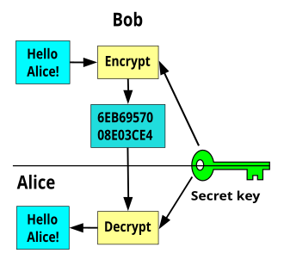
Grundbegrepp
Klartext, chiffer, nyckel

Slide 3
Grundbegrepp
Koda vs kryptera
Hello Alice! ->
-> Hej Alice!
-> 72 101 108 108 111 32 65 108 105 99 101 33
-> 01001000 01100101 01101100 01101100 01101111 00100000 01000001 01101100 01101001 01100011 01100101 00100001
-> 48 65 6C 6C 6F 20 41 6C 69 63 65 21
-> SGVsbG8gQWxpY2Uh

Slide 4
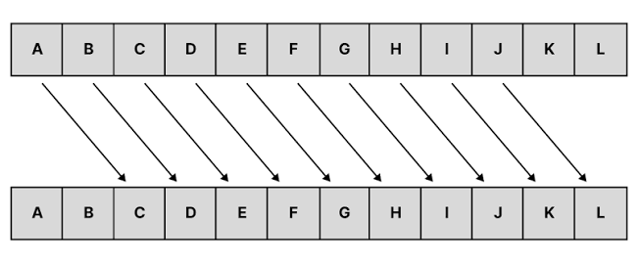
Ceasarchiffer

Slide 5
Ceasarchiffer
Jga Egcuct!
A | B | C | D | E | F | G | H | I | J | K | L | M | N | O | P | Q | R | S | T | U | V | W | X | Y | Z
C | D | E | F | G | H | I | J | K | L | M | N | O | P | Q | R | S | T | U | V | W | X | Y | Z | A | B

Slide 6

CyberChef

Slide 7
TWlsb2Jtcm9wIG15eXVrYg==

Slide 8
Fler krypton

Slide 9

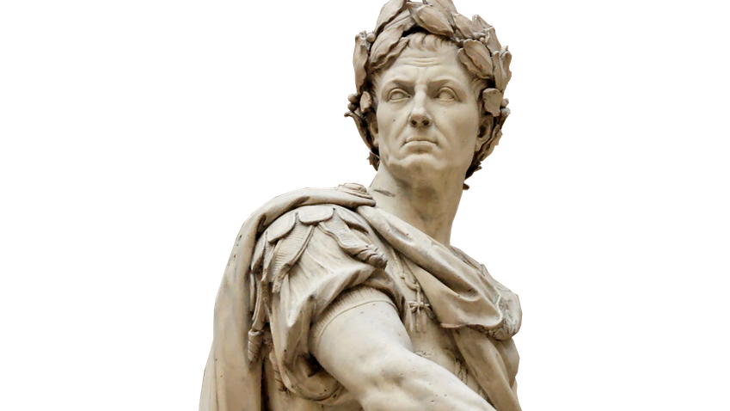
Fler krypton
Vigenèrechiffer
V | I | G | E | N | E | R | E
K | E | Y | K | E | Y | K | E
_ | _ | _ | _ | _ | _ | _ | _
A | B | C | D | E | F | G | H | I | J | K | L | M | N | O | P | Q | R | S | T | U | V | W | X | Y | Z
0 | 1 | 2 | 3 | 4 | 5 | 6 | 7 | 8 | 9 | 10 | 11 | 12 | 13 | 14 | 15 | 16 | 17 | 18 | 19 | 20 | 21 | 22 | 23 | 24 | 25

Slide 10
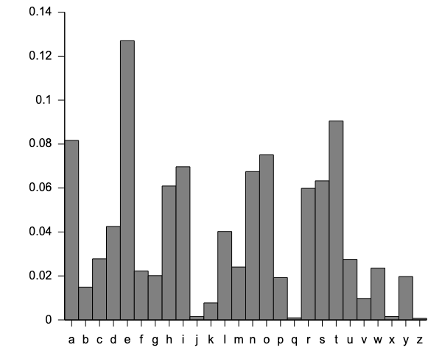
Fler krypton
Frekvensanalys

Slide 11
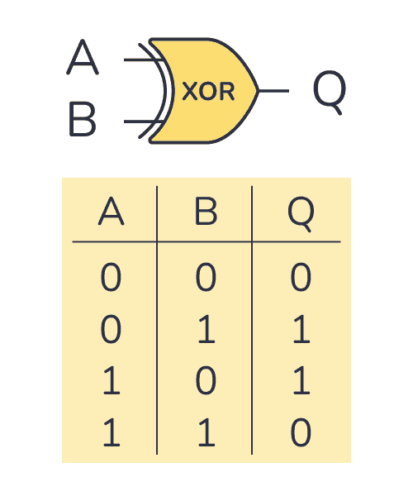
Fler krypton
XOR
G | a | r | d | e | n | e | r
h | e | y | h | e | y | h | e
_ | _ | _ | _ | _ | _ | _ | _

Slide 12
Fler krypton
XOR
G
h
0 | 1 | 0 | 0 | 0 | 1 | 1 | 1
0 | 1 | 1 | 0 | 1 | 0 | 0 | 0
_
_ | _ | _ | _ | _ | _ | _ | _

Slide 13
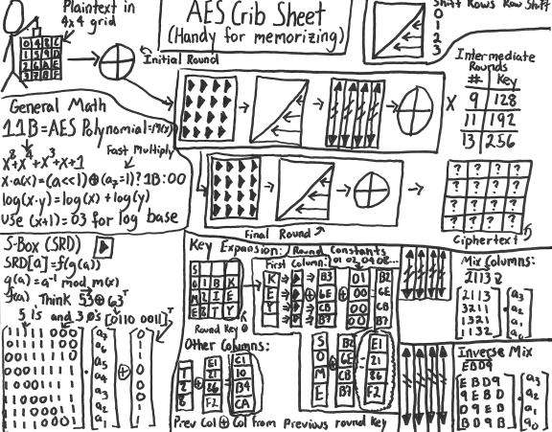
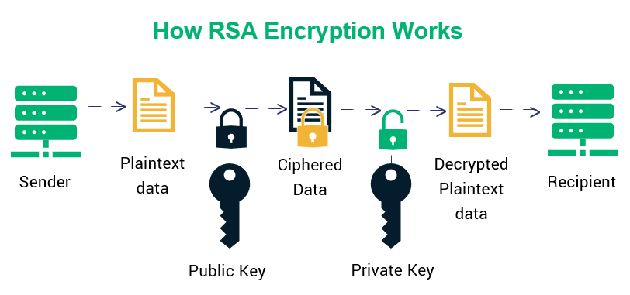
Fler krypton
Modern kryptologi
RSA
AES
ChaCha20
ECC
…

Slide 14
flagga{}

